Slide 1
Predictive analysis of storage health and performance for heterogeneous environment
Najmudheen & Xulin Huawei Technologies

Slide 2
Agenda
A glance to modern data center
Need for telemetry on Infrastructure
Delfin – an open source Infrastructure monitoring and alerting framework
Predictive analytics using ML
Anomaly detection algorithms
SODA
Bringing telemetry and anomaly detection together

Slide 3
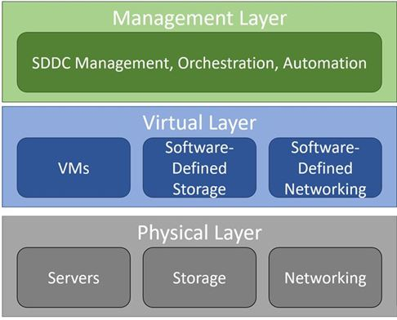
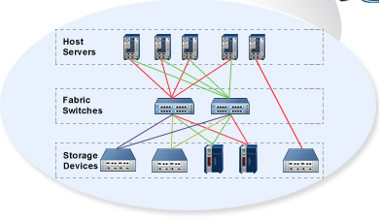
A glance to modern data center

Slide 4
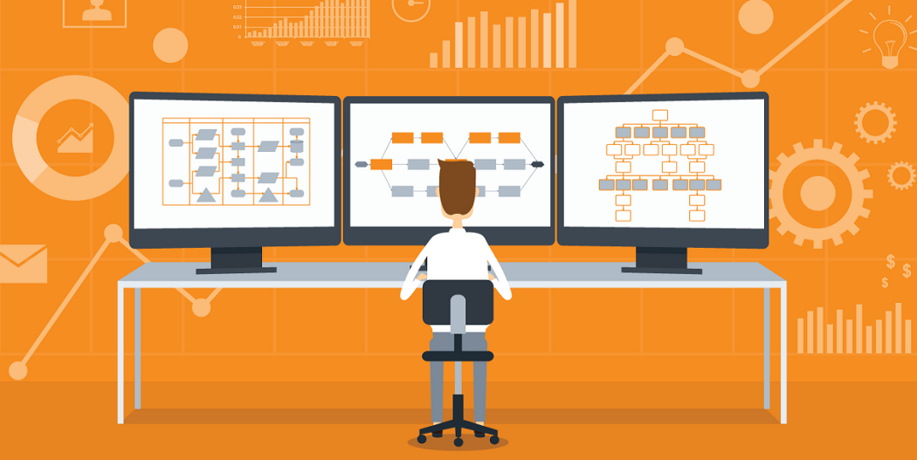
Need for Telemetry
storage resource management tools can be invaluable to organizations that need to simplify and optimize their storage infrastructure.
Every vendor has monitoring and reporting software for visualizing and analysing.
Different metrics of Capacity, Performance and configuration updates are to be monitored .

Slide 5
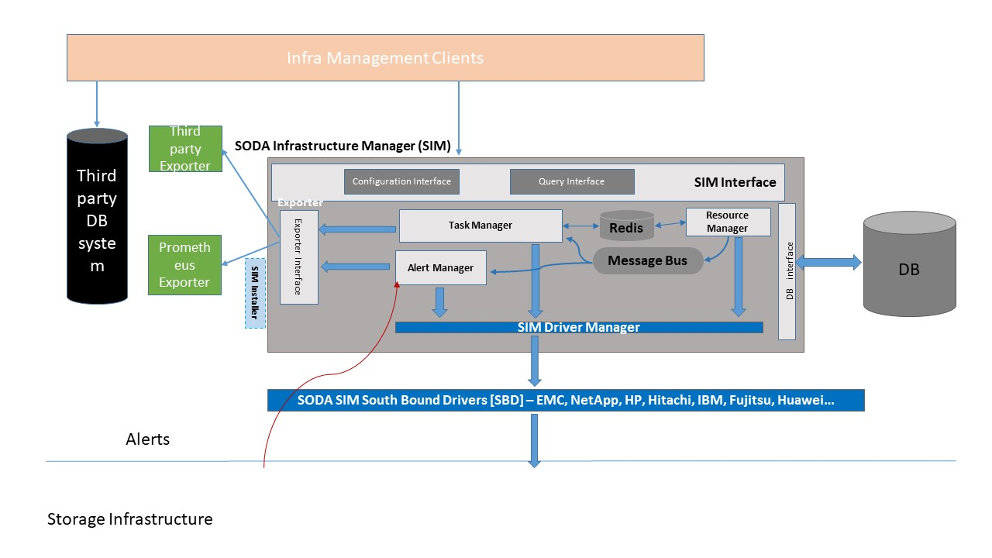
Delfin – an open source Infrastructure monitoring and alerting framework

Slide 6
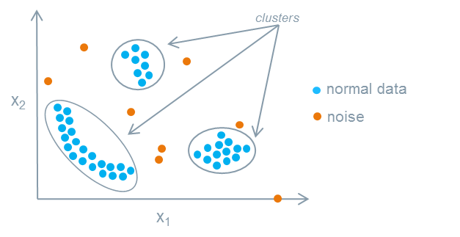
Anomaly detection : algorithms
Guassian
DBScan

Slide 7
SODA : Bringing telemetry and anomaly detection together

Slide 8
Please take a moment to rate this session. Your feedback matters to us.

Slide 10
Bullet one
Bullet two
Bullet 3
Bullet 4

